Slide 1


Slide 2


Slide 3
Loading…

Slide 4
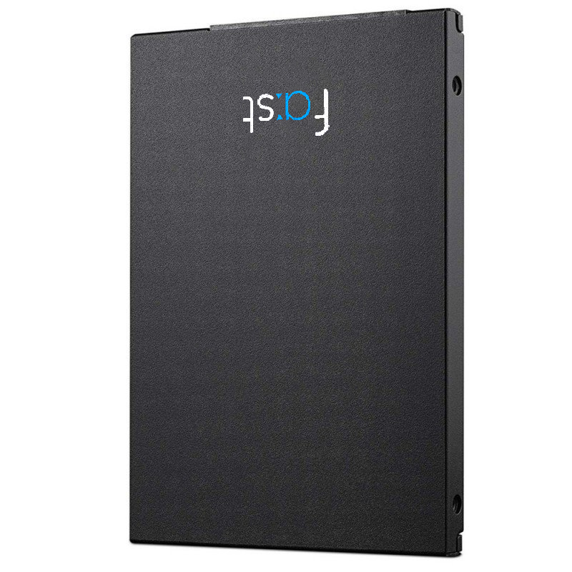

Slide 5
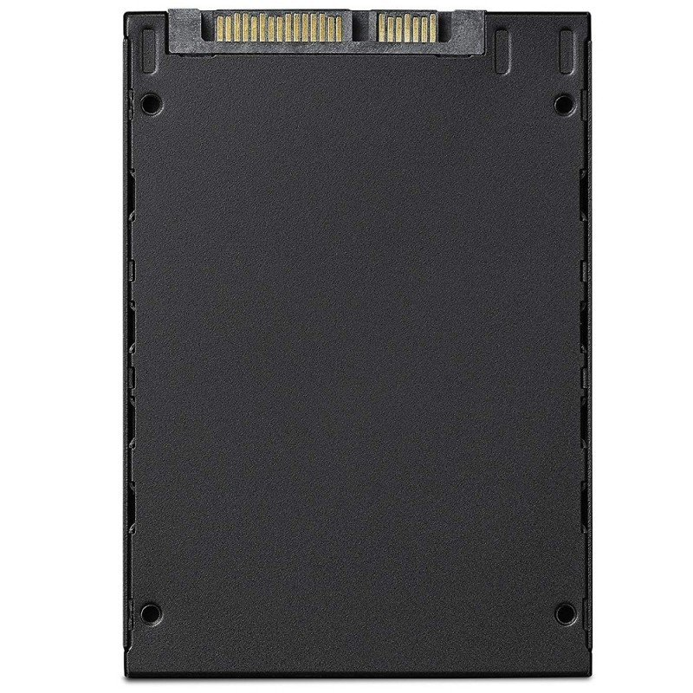

Slide 6
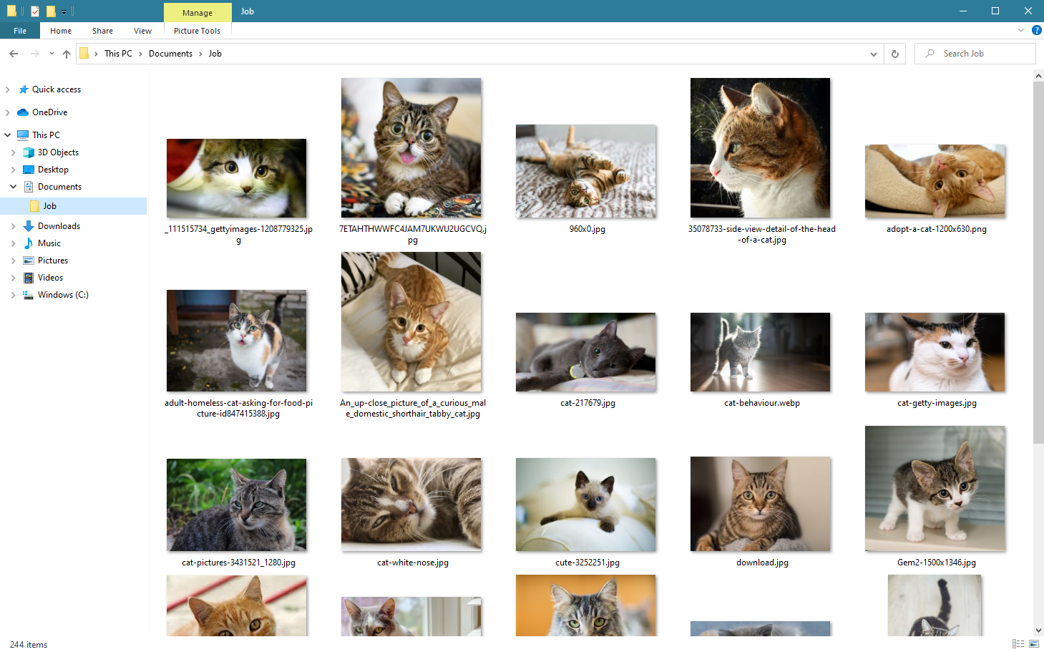
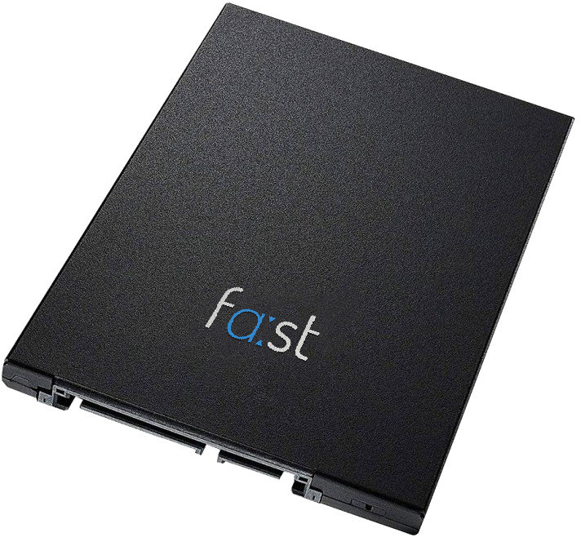

Slide 7
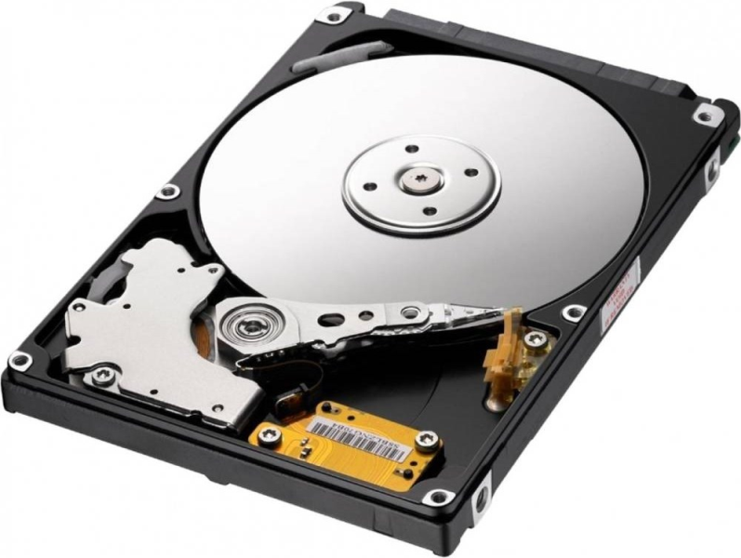

Slide 9
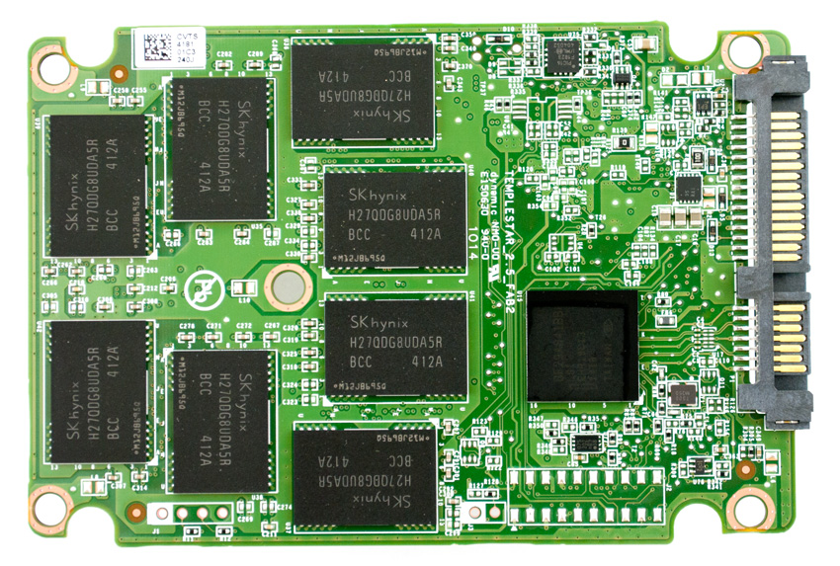
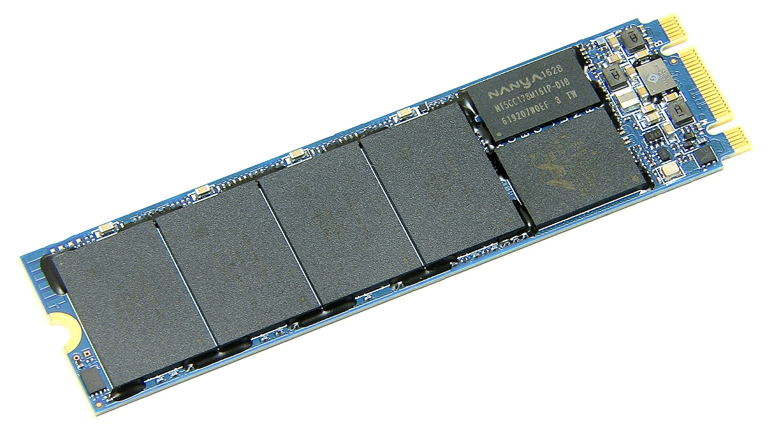

Slide 10
 | HDDs* | fa:st SSDs** | fa:st+ SSDs**
Sequential Read | 200 MB/s | 500 MB/s | 2000 MB/s
Sequential Write | 200 MB/s | 450 MB/s | 2000 MB/s
Random Read (4K) | 2 MB/s | 40 MB/s | 65 MB/s
Random Write (4K) | 2 MB/s | 100 MB/s | 140 MB/s
OS load time | 1 to 2 minutes | 10 seconds | 10 seconds
*An average consumer-grade HDD.
**Peak values measured in synthetic tests.
All tests were performed on a Windows 10, AMD Ryzen 3700X at 3.6 GHz, 16 GB 3200 MHz RAM machine.

Slide 11
SATA
M.2

Slide 12


www.fastdrives.com

Slide 13
Pricing
fa:st 120 GB
fa:st 240 GB
fa:st 480 GB
fa:st 1 TB
fa:st+ 240 GB
fa:st+ 480 GB
29 €
49 €
69 €
99 €
89 €
129 €

Slide 14

www.fastdrives.com
www.fasttech.com
fast technologies ltd.
10 Paradise St
Sheffield, UK
customer@fasttech.com
(0114) 496 1337

